Slide 1

Citation Skills for
MBA Students
MBA Fast Track, Summer 2010
Stony Brook University Libraries
Fiona Grady, Assistant Instruction Librarian

Slide 2

This presentation covers:
Plagiarism/Academic Integrity
When to cite – when not to cite
Citations (APA)
  How to read & create
  In-text citations
Citation Help

Slide 3

What is Plagiarism?
Plagiarism is taking words, phrases, ideas, images, sound recordings or other creative expressions that belong to someone else and representing them as your own.

Slide 4




Another’s work includes:
Text
Photographs
Music
Tables
Graphs
Laboratory data
Computer programs
Physical models
Chemical samples

Slide 5
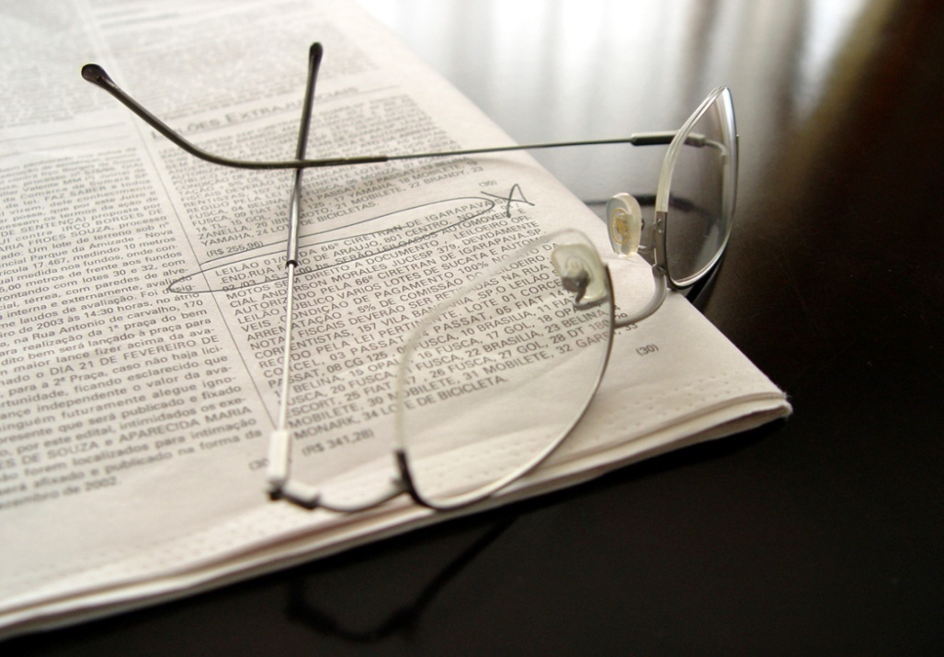
What else is considered Academic dishonesty?
Having someone else write a paper for you
Using another’s paper as your own
Buying or downloading a paper from the web
Submitting the same paper for more than one class without permission from instructor
Putting your name on a group assignment when you haven’t adequately contributed

Slide 6
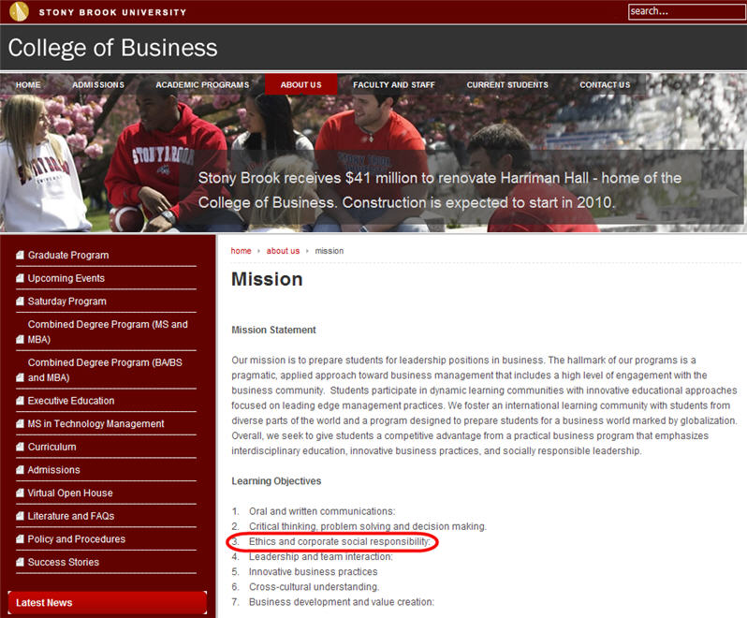
Added emphasis for MBA students
Ethics is a major emphasis in MBA programs

Slide 7

Common Knowledge
Common knowledge:
an idea(s) taken for granted by people knowledgeable about the topic. Facts easily found in standard reference books are considered common knowledge.
Common knowledge does not need to be cited.

Slide 8
Common Knowledge
Examples:
  2008 was a presidential election year in the United States.
  Smoking is harmful to your health.

Slide 9

What Else you don’t have to cite
You also do not have to cite:
    Your own experiences
    Your own observations
    Your own reactions

Slide 10
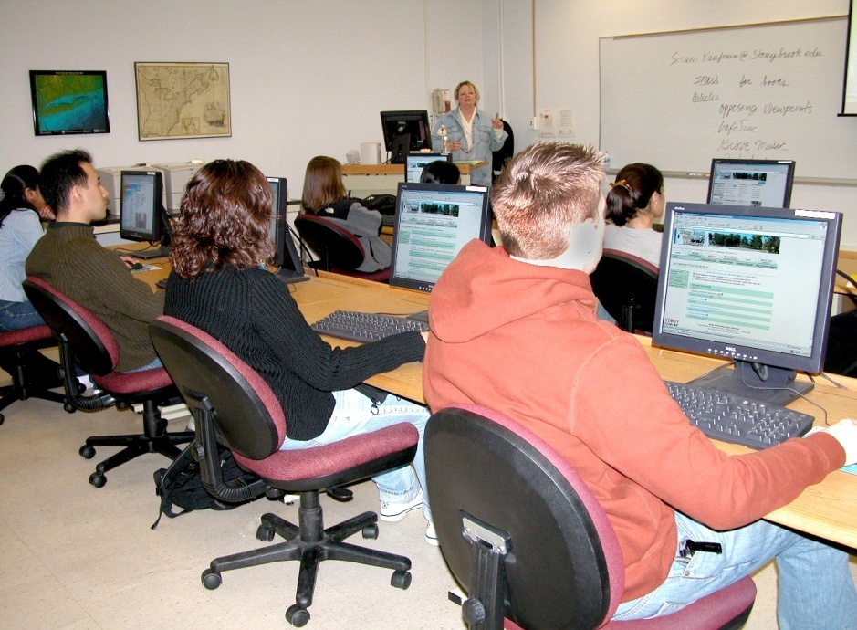
To cite or not to cite exercises
Arguably, Bart Simpson is one of the most popular mainstream American cartoon characters.
Answer: No

Slide 11

To cite or not to cite?
One critic says that Bugs Bunny taught us to critique power structures, or better, simply to seize them from the hands of the powerful clods. Bugs taught us attitude; he is the Lenin of camp.
Answer: Yes

Slide 12

To cite or not to cite?
In 2007, 5 famous American baseball athletes were found guilty of using illegal steroids for performance enhancement.
Answer: Yes

Slide 13

How to Avoid Plagiarism
Paraphrase
  Express ideas of an author using different words
Summarize
  In a brief manner, restate the material
Quote
  Use exact words surrounded by quotation marks

Slide 14
Misconceptions about plagiarism
It is not plagiarism if you paraphrase
Anything put in quotation marks is not plagiarism
Don’t worry about plagiarism if you found it on the web; things on the web are in the public domain
It’s not plagiarism if it’s unintended
They’ll never know – SafeAssign?

Slide 15
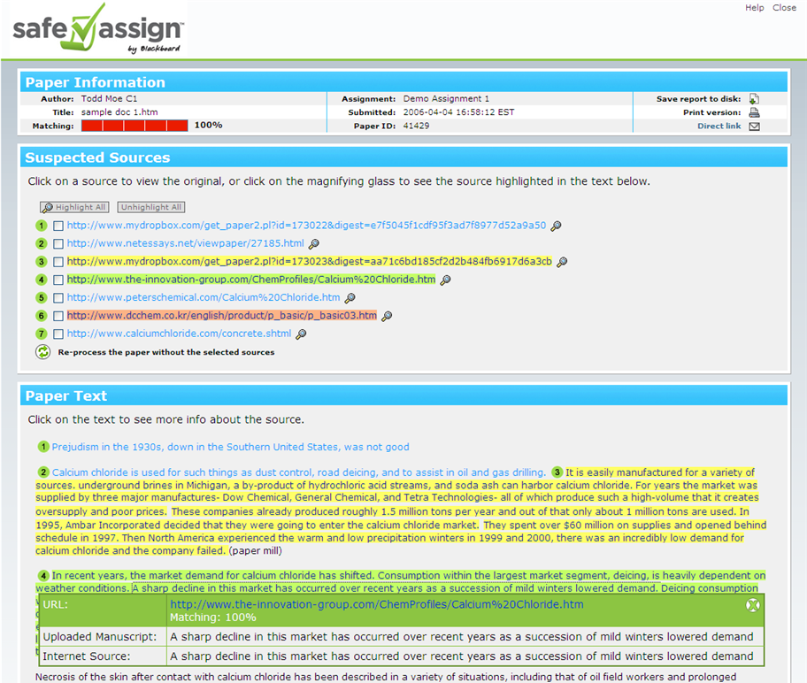
Blackboard Inc., 2007

Slide 16
Strategies
Mark quotes with a Q, paraphrases with a P
Include page numbers and source references
Print out web sites as they can disappear
Don’t cut and paste
Check for inconsistencies in font and layout
Does your paper contain different writing styles
Check to see if all your citations are listed on the References page
Plan ahead – research takes time

Slide 17
REAL LIFE CONSEQUENCES
  New Jersey valedictorian
    Was denied her seat as Harvard freshman
  Historian Doris Kearns Goodwin
    Had to step down as Pulitzer Prize judge
  Boston Globe journalist Mike Barnicle
    Forced to resign as Boston Globe columnist
  Senator Joseph Biden
    Had to drop 1987 campaign for the Democratic presidential nomination
  At Stony Brook:
  Q Course
  Expulsion

Slide 18
What is a citation?
A citation tells everyone the source of your information.
It answers the question:
Where did you get this information?
It allows readers to:
Verify the information presented is correct
Find out how the information was determined
Discover new sources in their field of interest

Slide 19
What Do Citations Tell You?
The author’s name
The title of the article
The title of the journal or book
The date it was published
The page is the information on
The URL of a website
All the information you need to locate the resource

Slide 20
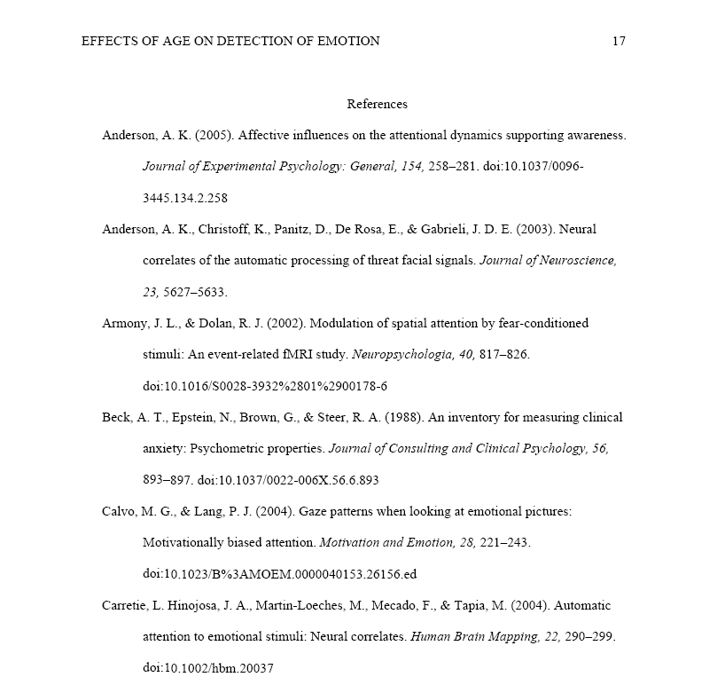
References list
APA, 2010

Slide 21
Scholarly, academic or peer-reviewed articles - Print
APA
Author, A. A., Author, B. B., & Author, C. C. (Year). Title of article. Title of Periodical, volume number(issue number), pages.
Use this format for electronic articles from databases too.
MLA
Author(s). "Title of Article." Title of Journal Volume number.Issue number (Year): Pages. Type of Material.

Slide 22
Scholarly article from the internet
APA – From an online journal
Author, A. A., & Author, B. B. (Date of publication). Title of article. Title of Online Periodical, volume number(issue number if available). Retrieved from http://www.someaddress.com/full/url/
MLA – From a library database
Author. "Title of Article." Title of Journal Volume number.Issue number (Year): Pages. Online Database Name. Web. Date of Access.

Slide 23
Scholarly Article from the internet
APA – From online journal
Bernstein, M. (2002). 10 tips on writing the living Web. A List Apart: For People Who Make Websites, 149. Retrieved from http://www.alistapart.com/articles/writeliving
MLA – From library database
Langhamer, Claire. “Love and Courtship in Mid-Twentieth-Century England.” Historical Journal 50.1 (2007): 173-96. ProQuest. Web. 27 May 2009.

Slide 24
Newspaper article Online
APA
Author, A. A. (Year, Month Day). Title of article. Title of Newspaper. Retrieved from http://www.someaddress.com/full/url/
MLA
Author(s). "Title of Article." Title of Periodical Day Month Year: pages. Medium of publication.

Slide 25
Websites
APA
Author, A. A. (Date of publication). Title of Page/Document. Retrieved from URL.
How to Make Vegetarian Chili. (2009). Retrieved from http://www.ehow.com/how_10727_make-vegetarian-chili.html.
MLA
Author. "Title of the Web Page." Title of the Overall Web Site. Version or Edition. Publisher or Sponsor, Date. Web. Date of Access.
"How to Make Vegetarian Chili." eHow.com. eHow, n.d. Web. 24 Feb. 2009.

Slide 26
Book citation - formats
APA – 6th Edition
Author, A. A. (Year of publication). Title of work: Capital letter also for subtitle. Location: Publisher.
Note: For "Location," you should always list the city and the state using the two letter postal abbreviation without periods (New York, NY).
MLA – 7th Edition
Lastname, Firstname. Title of Book. Place of Publication: Publisher, Year of Publication. Medium of Publication.

Slide 27
Book Citation – one author
APA
Brown, D. (2003). The Da Vinci code: A novel. New York, NY: Doubleday.
MLA
Brown, Dan. The Da Vinci Code: A Novel. New York: Doubleday, 2003. Print.

Slide 28
Multiple Authors or no author
APA
Differences for more than 3 authors
Title displayed first if no author
MLA
First author uses last name, first name but additional authors use first name last name
May use et al. when more than three authors

Slide 29
No Date
APA
Use n.d. if publication date is not available.
MLA
Use n.p. if publisher information is not available for websites.
Use n.d. if publication date is not available.
Familiarize yourself with rules for
other exception conditions!

Slide 30
MLA – Notes on online resources
When using MLA, use Web as medium of publication for online resources
MLA no longer requires the use of URLs unless the material is difficult to find

Slide 31
Parenthetical or in-text Citation
Directs readers from the text to the full citation in the Works Cited or References list at the end of the document
Replaces the use of citational footnotes
If author’s name is mentioned in text
  Daniel J. Boorstin (1973) has noted that most Americans considered the telephone as ….
If author’s name is not mentioned in text
  Most Americans did not consider the telephone as major invention (Boorstin, 1973).

Slide 32
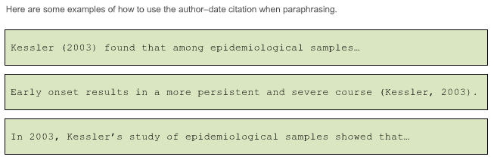
In-Text citations - examples
APA
(American Psychological Association, 2010)
Example using page number:
The popularity of the film Shaun of the Dead supports Carroll’s (1999) claim that the horror-comedy subgenre is becoming more prominent (p. 145).

Slide 33
Getting Help on Citations
Library handouts on citations
Ask a Librarian or your instructor
Guides on the internet (look for those from academic libraries)
Citation tools like Zotero, EndNote, or Citeulike
Some databases automatically format citations for you
YOU ARE ULTIMATELY RESPONSIBLE FOR ACCURATE CITATIONS

Slide 34
Online resources for citation
Tutorials
APA Tutorial from the American Psychological Association @ http://www.apastyle.org/learn/index.aspx
Online Writing Lab at Purdue University (APA, MLA, Chicago) http://owl.english.purdue.edu/owl/
Research and Documentation Online (Use 2009 MLA and 2010 APA updates links)
http://www.dianahacker.com/resdoc/
Bibliographic Management Tools
Zotero (free plug-in for Firefox) http://www.zotero.org/
EndNote (SBU site license) http://it.cc.stonybrook.edu/software/students/endnote

Slide 35
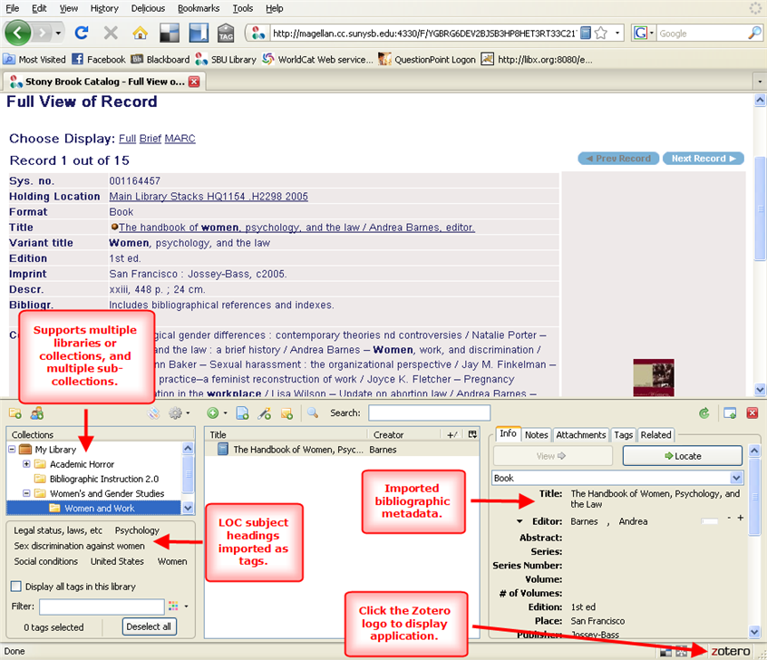

Slide 36
Thanks & questions
Thanks to Susan Kaufman for use of her plagiarism presentation on which part of this presentation is based.
Questions?
Fiona Grady, fiona.grady@stonybrook.edu
Susan Kaufman, 631-632-9417, susan.kaufman@stonybrook.edu

